Slide 1

Spatial Arrangement in
Video Conferencing
Team Limetten

Slide 2
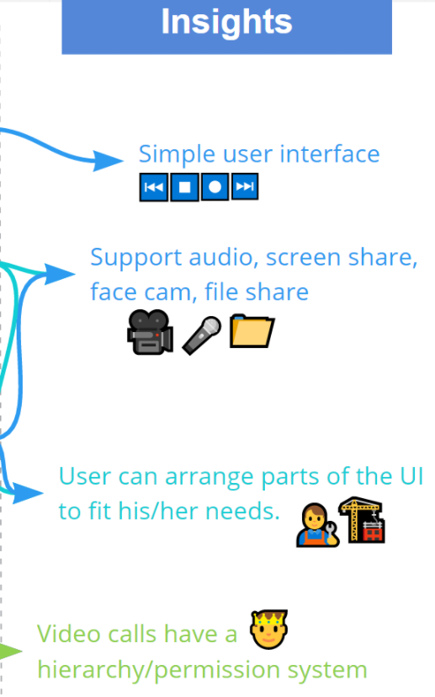

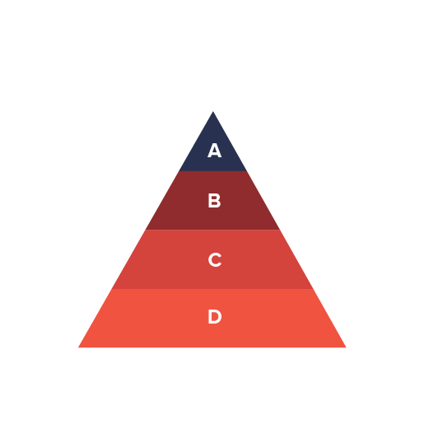
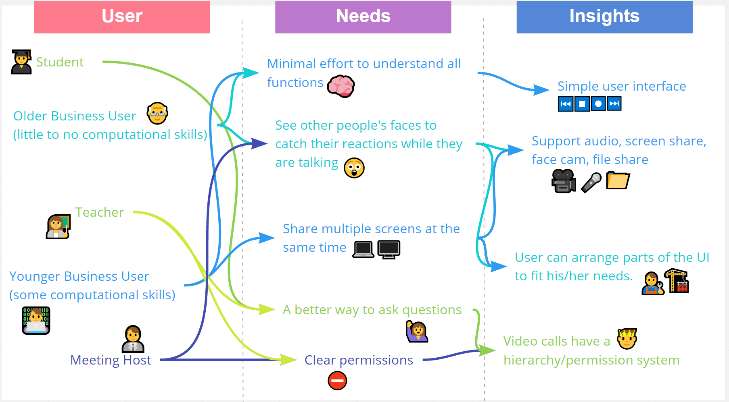
Ideation
User-specific Conference Arrangement
Level-based Permissions
Notes:
As a takeaway from the ideation phase, our most important insights were the following:
Most interviewees prefer a simple UI.
The arrangement of participants should be up to the user in some way.
Screen sharing & file sharing should be easier and support additional features.
There should be a better permission/role system within a call.
After multiple iterations of brainstorming and collecting feedback, we decided to merge two of our ideas of called Level Based Permission System and User-Specific Conference Arrangement in some ways.

Slide 3
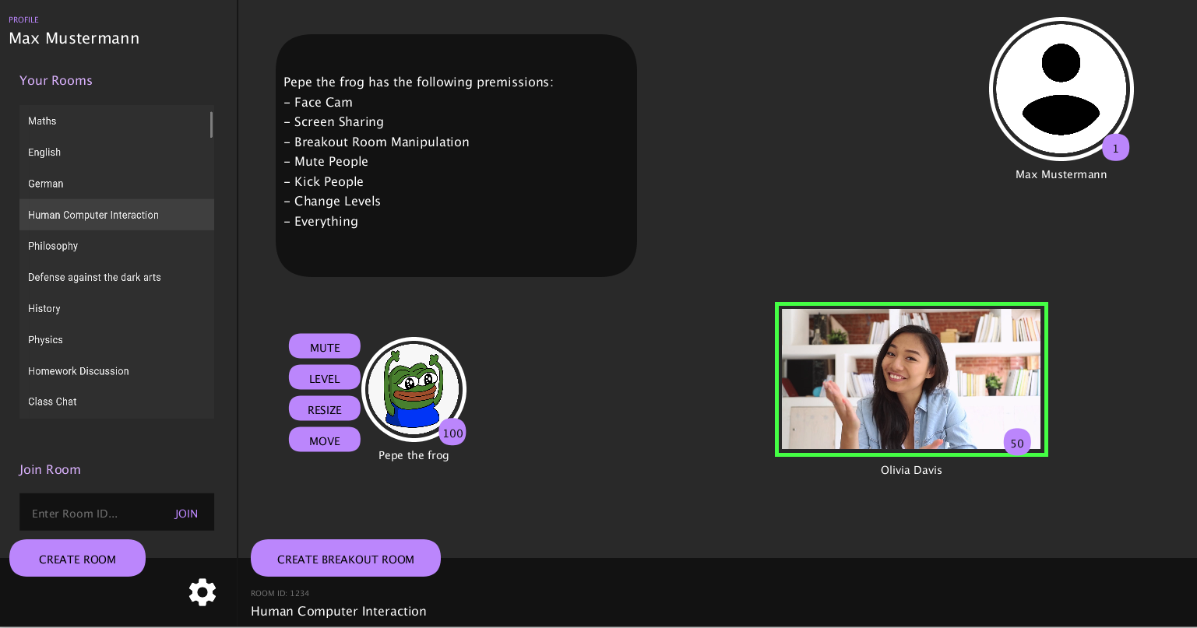
Hifi Prototype
Notes:
Following the evaluation of our user study, we decided to keep going with combining our basic approaches, as both these ideas met with approval among the participants. We were finally set up to start building the frontend of our hifi prototype using Processing. The focus on size, position and appearance of bubbles that represent each participant and the desire of giving the user the ability to change these on his own could not be technically met by any standard library for UI, which is why we decided to create our own solution. Our own library supports not only that but also further functionalities such as breakout rooms, screen sharing and a level based permission system.
Then, we were set for optimizations.

Slide 4

Optimization
Which feature to optimize?
Feature | Variables
Button Layout Order of buttons when a user is clicked. | Order of button
Cluttering Prevention Position of each user when entering the room/session | x, y position
Order of settings | Order of buttons/input fields
Priority order hierarchy (screen share, muting, etc.) | Integer number
Notes:
We came up with different ideas for what features we could optimize
Many of them involved how we order buttons, we did not want to do that.
For most of them it probably makes more sense to conduct a user study
We tried finding a meaningful optimization that is unique to our application
We settled on optimizing the screen positions of a new user if they join a room
Optimization reduces clutter
Optimizes the position of the user only, size is fixed
Next, we go more in depth into the optimization pipeline

Slide 5



Optimization
Optimization pipeline
Locations, Size of existing user-bubbles
Location of new user-bubble
Optimization algorithm
Notes:
Frontend done in processing (UI)
If a user joins, sends locations, sizes of all other users to Backend
Backend done in python, does optimization.
Backend computes the optimal position for the newly joined user and sends it to frontend
Processing frontend then renders the new user at the computed location
Can also be done over network, not on same local machine.
Optimization could potentially be done by a powerful server.
Next, we talk about the pipeline under the hood

Slide 6




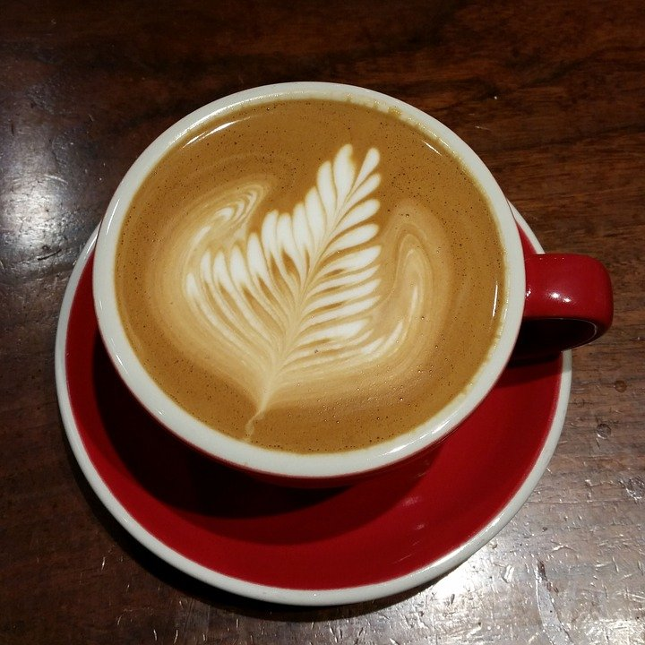


Optimization
Optimization target
“Under the hood”
x, y - position
r - radius
Global minimum
Non-linear constraints
Optimizer
Initial condition
Notes:
Beginning call from processing: new user joined
lobby,
all preexisting user (pos. and radius) in a .csv file
build non-lin. constraints (e.g no bubbles crossing each other, bubbles not out of screen)
Define optimization target. In this case center of screen
Define initial condition (most difficult part)
Run in optimizer with cost as distance from new bubble position to target position
Check solution for global minima, very sensitive to initial condition.
Send found position back to processing
All happening in real-time

Slide 7



Optimization
Optimizer Algorithm
States and Cost:
Non-linear Constraints:
Notes:
[Explain picture]
Solved with library SciPy and Numpy in python
Used function minimize() with solver 'trust-constr' which supports scalar cost and non-linear constraints
Is fastest compared to other methods aviable from SciPi
Final algorithm is able to use different radii, position and distance threshold between bubble circle for optimal position of new bubble
Brings us to difficulties of finding global minimum, which is highly dependent on initial condition

Slide 8
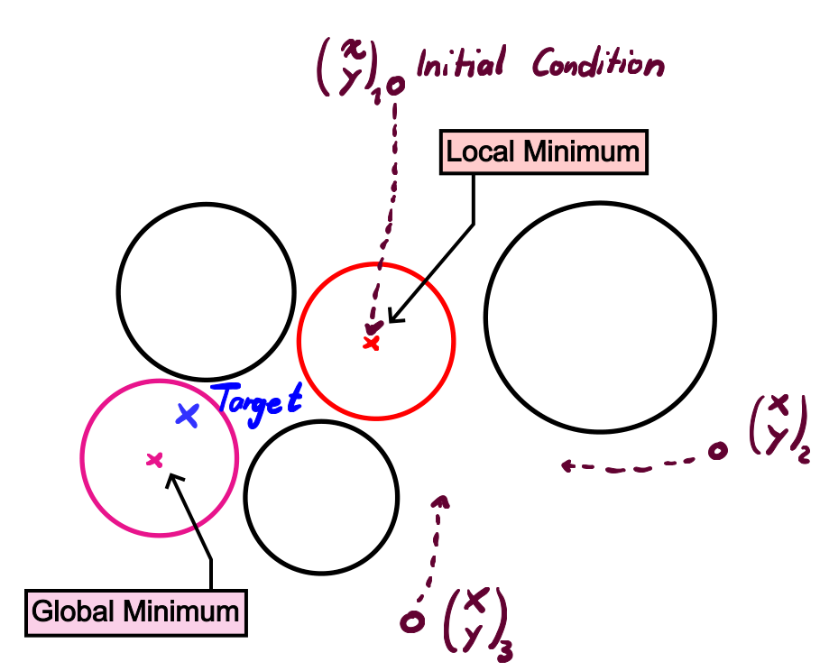
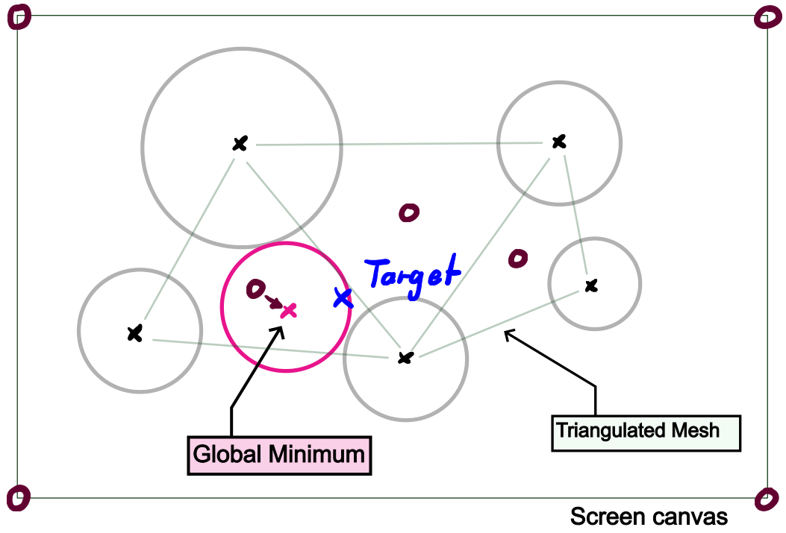
Optimization
Initial condition and global minimum
Random position of IC
Triangulated mesh center as IC
Notes:
Main difficulty to find global minimum in optimization
Solver gives only local minimum for each iteration with particular IC, due to constraints [left] can be computation expensive many ICs (Monte-Carlo Sampling)
Exact problem is step size in optimization algorithm not being large enough to overcome constraints
Using screen corners and center of each generated mesh triangle gives robust algorithm. Global minimum is guaranteed with minimal effort.

Slide 9
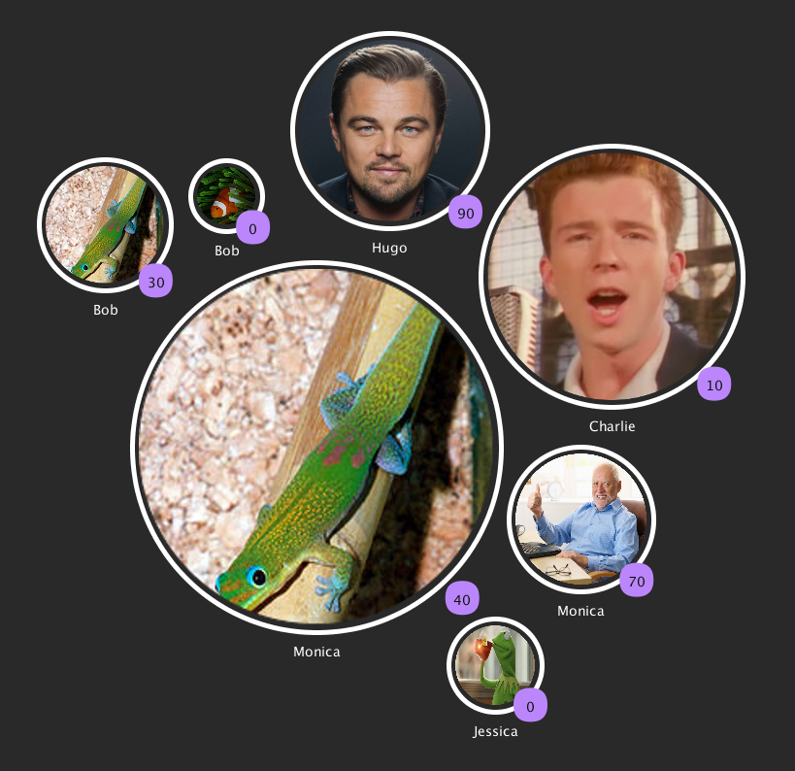
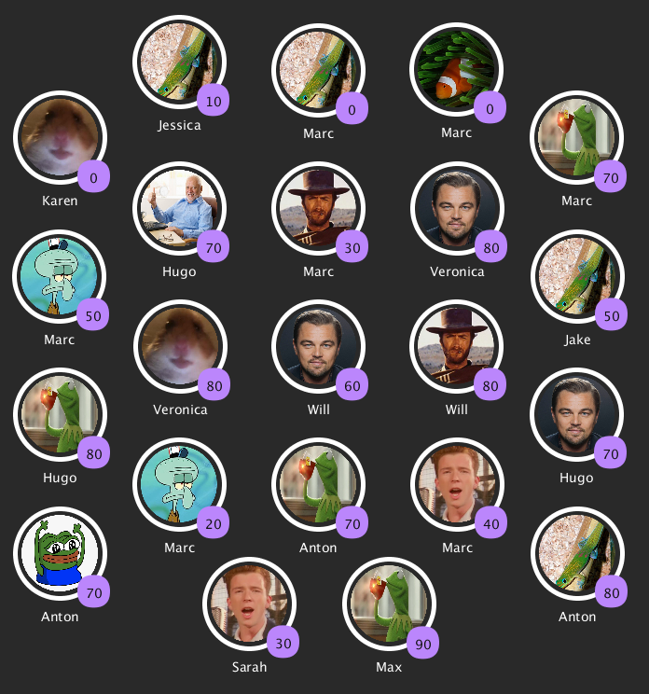
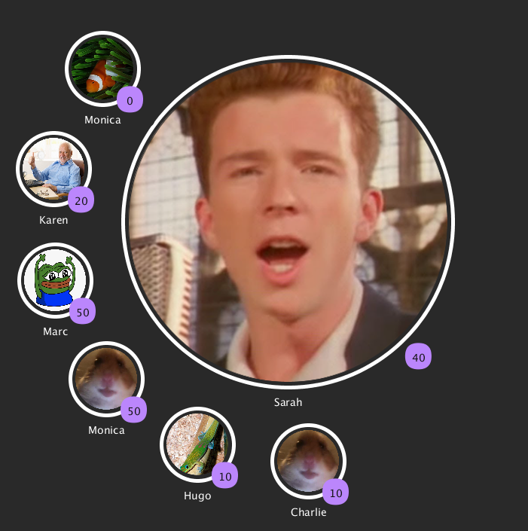
Results

Slide 10
Questions?

